Slide 1
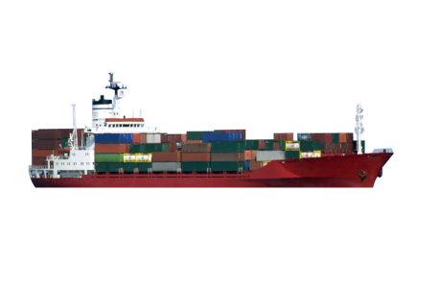
Maritime Cloud
A technical framework to support seamless information transfer
in e-navigation
Ole Bakman Borup
Danish Maritime Authority
Maritime technology and e-navigation

Slide 2
Background
The overarching e-navigation architecture, decided by IMO, assumes seamless data exchange between maritime actors onboard and ashore
Testbed experience with potential e-navigation solutions has shown a need for a technical framework to support this data exchange

Slide 3
Identified framework requirements
New communication means
Service consumers must easily be able to locate provided services
Service providers must easily be able to register their provided services
All maritime actors must have a unique maritime ID with attached attributes as role and nationality, etc.
Means for secure communication
Authenticity – Guarantee of who I am talking to
Integrity – Guarantee that data is unaltered
Confidentiality – Guarantee that data is not accessible by third party

Slide 4
Guiding principles
Re-use not re-invent
Utilize existing and proven Information and Communication Technology (ICT) concepts
Distributed systems
Service-oriented architecture
Software design patterns
IT security
Etc.
Separation of information provision and consumption
Actors are often both providers and consumers of information
Not ideal to decide in advance who will need what information, obtained from whom and when
Decoupling providers of information from the possible consumers allows the number and nature of providers and consumers can evolve through time

Slide 5
Guiding principles, continued
Loose system coupling
Modular design with loose coupling and high cohesion where components of systems have little or no knowledge of the definitions of other separate components. By doing this the barriers between systems and applications are removed, and interfaces are compatible. It allows for independent acquisition and composability of system components.
Build on open standards
Open standards means widely accepted and supported standards set by recognized standards organizations or the marketplace. These standards support interoperability, portability, and scalability and are equally available to the general public at no cost or with a moderate license fee.
Facilitate Service Oriented Architecture (SOA)
Driven by analysis of user needs, functionality is developed, packaged and implemented as a suite of interoperable services that can be used in a flexible way within multiple separate systems from several domains within the maritime world.

Slide 6
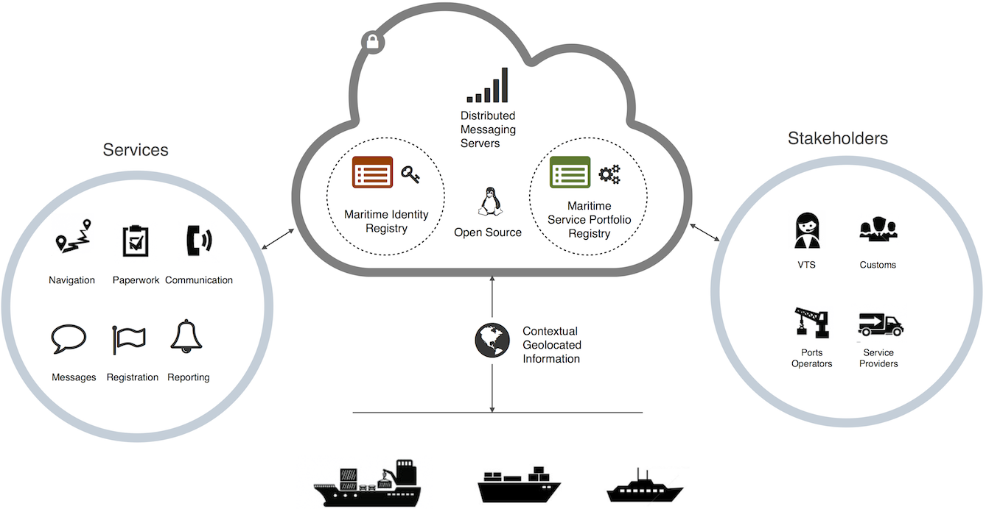
The Maritime Cloud
Connects all maritime actors in a communication framework
Consists of standards and three key infrastructure components

Slide 7
Communication
Digital communication means are essential for a communication framework
Currently we have only one general purpose digital communication mean universally available
AIS ASM
In some cases we have
Commercially available Internet (TCP/IP)
Stand alone text based or limited data package transfer systems via satellite or HF
Questionable if AIS ASM will be sufficient for the prioritized e-navigation solutions
New communication systems (like NAVDAT and VDES) need to be developed and demonstrated – i.e. not available in the short term.
The Maritime Cloud must be able to utilize different communication systems

Slide 8
Internet
Internet connectivity will surely play a bigger role in the future – not necessarily driven by e-navigation but by a business and crew demand
The IP protocol offers an interface that can be delivered by multiple physical links
Mobile broadband
SAT
WiMAX
VHF data
Connectivity would incur costs, even for statuary communications
Crew and business communication expected to highly exceeds statuary communication
Efficiency savings due to the use of the Internet will be orders of magnitude higher than the additional costs
The standard Internet transport protocols TCP and UDP are not sufficient for all kinds of needed communication

Slide 9

Maritime Messaging Service
Geo-aware messaging protocol on top of TCP/IP (overlay network)
Actors connects to a Maritime Messaging Server (MMS) to send and receive messages, and send position at a protocol level
The servers maintain a geographical awareness of actors
Can be supplemented by AIS data
Any available Internet connection can be used (prioritized)
Resilience by store and forward functionality
MMS
MMS
MMS
VTS, MRCC, Port, Shipowner…

Slide 10
Maritime Messaging Service – features
Actors can send messages directly to other actors (no range limitations)
Geographical awareness enables geocasting (broadcast to given area)
Actors can listen to a specified area – or a specific service
Geocast is an implicit feature of many radio based communication systems
Emulation of current and simulation of future communication systems
Broadcasts
Listens
VTS, MRCC,
Port…
Listen – or Geocast

Slide 11
Maritime Identity Registry
Distributed registry maintained by a number of identity brokers in a peer-to-peer network
All actors in e-navigation will obtain a Maritime Identity in the Maritime Identity Registry
Similar to callsign or MMSI but not tied to role or specific technology
Security through public-key infrastructure
All actors will obtain a digital certificate (with variable trust)
The registry contains minimal required information about the actors
Static information (e.g. contact information, callsign, comm. capabilities etc.)

Slide 12
Maritime Service Portfolio Registry
Distributed registry maintained by a number of service brokers in a peer-to-peer network
Registry of service instances
A service instance links
Service (specification)
Service provider (identity)
Coverage of the instance
Technical end points
Service specific metadata (e.g. quality)
The specification of a service is envisioned to be located in the product specification part of the IHO S-100 GI Registry
Service providers maintain their provided services in the registry
Service consumers can locate available services
All actors can act as both service providers and consumers
Intended to span all maritime services

Slide 13
Service?
Service is a very generic term with different interpretations in different domains
In the e-navigation process: Operational Services provided through a number of Technical Services
Broad term: Includes radio based voice and non-structured data services
Data/information services (structured data, machine-machine)
Exchange of messages between a service provider and a service consumer according to a specified protocol or exchange rule
Messages specified as S-100 data products
Delivery mechanism for S-100 data products (message = dataset)
Services may have different variants
Transport, protocol and encoding
E.g. MSI over NAVTEX, NAVDAT or web service
Different models or mappings
S-100 PS scopes provides way to specify variants

Slide 14
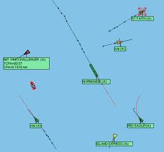
Almanac
Offline digital version of the public part of Maritime Identity Registry and Maritime Service Portfolio Registry
Comparable to an advanced electronic “white pages / yellow pages” phonebook
Updated regularly (downloaded or carried onboard)
Identity and service registries available offline
Identities can be authenticated
Data encryption for full confidentiality
Find contact information etc. for actors
Find provided services for areas
Etc.
Demo
SHIPS
ENRICO III
EMA MAERSK
ESVAGT ALPHA
…
Ports
Aberdeen
Amsterdam
…
MRCC
Reykjavik
Thorshavn
…
VTS
Brevik VTS
Fejde VTS
…
WEATHER
Danish Meterological Institute
…

Slide 15
Use cases
Automatic reporting
Location of reporting endpoints
Confidential exchange
Promulgation of Maritime Safety Information and Notices to Mariners
Discovery of provided services along planned route
Retrieval of relevant messages along route
Receive broadcast messages underway
Nautical publications can be provided through data services
Human readable (e.g. web or PDF)
Machine readable for system integration
Authenticity and integrity can be guaranteed using a common security solution
Access can be restricted based on maritime id and authentication
Industry can provide existing proprietary services on an open platform
Endless use cases

Slide 16
The Maritime Cloud and other concepts
Scalable enabler of seamless information exchange between various systems across different communication links
STM
Single window
e-navigation
services
e-navigation
services
e-navigation
services
Maritime Cloud Maritime Identity Registry; Maritime Service Portfolio Registry;
Maritime Messaging Service
Internet
AIS ASM
VDES
COM…
COM…
COM…
Functional pillars with isolated solutions for communication, security, service discovery, etc., must be avoided

Slide 17
Highlights
e-navigation as an framework and services as “apps”
Services will be able to evolve dynamically and can be provided by all maritime stakeholders, including commercial
Builds on existing proven technology i.e. cost effective
Security solution is proven and used today in e.g. the financial sector
Identity allows data sharing policies to be enforced
Facilitates seamless transfer from existing to new communication means
Availability and scalability addressed through distribution in a peer-to-peer architecture
Testbeds will early on be able to utilize the Maritime Cloud as a communication framework to evaluate potential e-navigation solutions, and to evolve and mature the framework itself
Has been submitted to the IMO e-navigation process as a proposed framework that will support e-navigation in the short and the long run

Slide 18
Status and the way forward
The framework is currently being progressed in the ACCSEAS project where the Maritime Cloud is serving as the testbed infrastructure
A prototype version of geo-messaging is being used in ACCSEAS, MonaLisa 2, and in global testbed trials in Korea (April 2014)
Agile approach in which the the concept is continuously evolved and evaluated in practice
Conceptual and practical work progresses in parallel
Source code is open source for evaluation and collaboration
Political aspects to be investigated
Possible governance structures
Legal, cost and operational issues
International collaboration, project and other fora
Possibly launching an operational version of the Maritime Cloud in the Baltic Sea region in 2015
Website: http://dev.maritimecloud.net/

Slide 19
Thank you!
Contact information
Email
obo@dma.dk
Website
http://dev.maritimecloud.net/
Google group
https://groups.google.com/d/forum/maritimecloud

